Slide 1
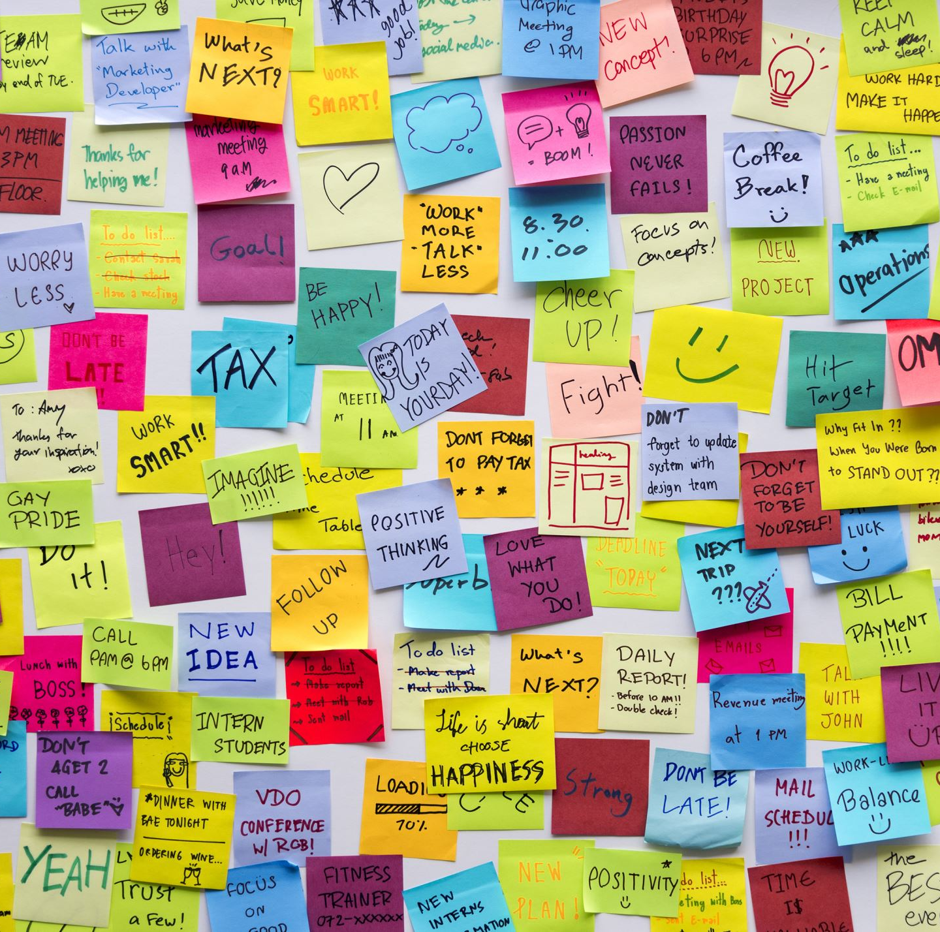
Strategies for ADHD Rebecca Steil-Lambert, MSW, LICSW, MPH

Slide 2
Focus and Concentration
This Photo by Unknown Author is licensed under CC BY-SA-NC
This Photo by Unknown Author is licensed under CC BY-SA-NC

Slide 3
Focus and Concentration
Pomodoros Always “small tomatoes” (25 min limit for focusing on a task) then a 5 min break.
Dopamine- Stimulants release Dopamine but so does music on headphones (no lyrics) and exercise!
Physical activity before sitting down to do a Pomodoro
Novelty is important
Eliminate Distractions in your environment and on your computer.
Use a Distraction Log, which then becomes your To-Do List. Anything that distracts you goes on the log. You attend to that log after your task is done.
Truly Understand and Define the Task and Create a Narrative of how it will get done

Slide 4
Dopamine is a Neurotransmitter or chemical messenger in the brain, which is increased by stimulant medications for ADHD but can also be increased through:
Meditation
Eat healthy sources of protein (Nuts, eggs, beans, beef, chicken, fish, lamb, nuts)
Foods known to increase dopamine include chicken, almonds, apples, avocados, bananas, beets, chocolate, green leafy vegetables, green tea, lima beans, oatmeal, oranges, peas, sesame and pumpkin seeds, tomatoes, turmeric, watermelon
Listen to music (without Lyrics)
Get Sunlight
Exercise (20-30 min a day minimum)
Spend Time in nature/green spaces

Slide 5
Avoid Multi-Tasking at all costs
Block Extraneous Noise (Loop quiet Ear plugs for noise reduction)
Connect with Nature. Green space is key when it comes to sharpening your cognitive skills. Get outside. Good for Mood as well.
Playing Specific Games can help you get better at concentrating (Chess, Scrabble, Word Finds, Concentration Card Game)

Slide 6
Week 2 Organization and Planning Strategies
Handle papers/mail once
For incoming mail have folders ready (Bills, Social, Medical, Call)
A Home for All Important Possessions!
No temporary homes for important stuff!
Use Phone Reminders
Use Siri and Alexa Hacks or Echo Dot to make grocery or shopping list/keep grocery list, call phone etc Can place Amazon Orders with your voice with Alexa or Echo; Use Timer Requests; Ask how much time is left on Timer etc Ask Alexa to call your phone when you can’t find it
Assign priority level to your To Do lists
Address Time Awareness Phone provides distraction so use some other time piece for keeping track of time. Make time visible.
Address Media Consumption. Be intentional with what you read or watch. (Is THIS worth my time and attention?)
Focus on Clear Surfaces

Slide 7
Week 2 Organization and Planning Strategies
Use 1 notebook for your distraction log/to do list
Google Calendar to coordinate scheduling within a Marriage/Relationship/Family
If it’s not written down it does not exist! Write it down!
Take 15 minutes each night to organize what you will wear and what you will eat the following day
3 Things before bed: Plug in phone in its home; Set alarm; Hygiene routine- (may include meds)
Shower at night Most folks with ADHD are not morning people
Let people help you. Ask family for reminders.
Leave earlier than you think you should leave; Set clocks 10 minutes early; factor 10-15 minutes extra into your planning
For better organization at home, go through each room in your home, and reduce your inventory entirely.
Inventory must equal space

Slide 8
Consider ways to decrease Decision Fatigue: Steve Jobs Chose to Decrease Decision Fatigue By Choosing the Same Outfit Daily...so did Einstein and also Mark Zuckerberg has several repeat outfits (Casual/Business).
This Photo by Unknown author is licensed under CC BY-SA.

Slide 9
Week 2 Organization and Planning Strategies
Leave some extra room in drawers and shelves
Once you reach a level of orderliness, use the 1 in =1 out rule
If it helps you clear your closet, think of someone to donate your items to, and then add things to the give-away pile that might work well for them
Arrange clothing in your closet by color; Simplify wardrobe
Dress in black when you are in a rush OR Keep an emergency outfit inside your closet door. Or wear same outfit every day (Einstein, Steve Jobs, Mark Zuckerberg all do/did outfit repeats)
Put things back where they belong (no temporary homes!)
Design systems that work for you (coat rack by the door you use)
Chunk out organization projects (think in steps ?)
If you have the money, perhaps hire a professional organizer
Don’t over-shop for food that can go bad. Put produce and cold cuts in the center of a shelf at face level. Don’t use drawers for perishables.

Slide 10
Clutter is a Problem for Everyone
If you have recurring clutter its playing a role for you. Why is the clutter helpful to me? Am I hanging onto items I use for motivation? Or am I worried about forgetting the past or forgetting people? Why might I want the clutter around me? Do I keep my house messy to avoid socializing/having people over? Try working with a therapist to better understand what role clutter is playing.
Validation for the clutter struggle: We have never in history had so much STUFF
Do bite-sized projects that can be started and finished.
Does your STUFF work for you? If it feels like clutter you may be outgrowing it
Use a 20 minute timer and see what you can get done to de-clutter a small area in 20 minutes.

Slide 11
People with ADHD tend to do “one more thing” before leaving the house…
Notice when you are in this behavior pattern, stop what you are doing, and leave the house.
Leave early and experience what its like to have time for things to go wrong. Suddenly traffic or spilling coffee everywhere or something breaking is not as stressful. Notice that on normal days something can very likely go wrong.
Ask roommate/partner/family to point out when you are doing “one last thing” before leaving. Ask for an accountability buddy.
The ADHD brain often excels in crisis situations. And there's no question that waiting until the last minute increases adrenaline and keeps you motivated until the finish line. However, this is not a relaxing way to live your life. Experiment with breaking old patterns and establishing a routine for leaving. Example of Leaving Routine= Shoes, jacket/sweater, keys, phone, purse, lunch; let dog out, pet all the animals and check water, put meds in pocket w/ any meds due, any supplies needed for work or after work? (Would these look good on post-it note by the door?)

Slide 12
Week 2 Organization and Planning Strategies
If you have young children, use easy to reach bins to store toys
Check your To-Do List during a mid-day break
Set a bedtime alarm and go to bed on time
Make sure you are using lists and learning to Triage (Today, This Week, This Month)
Use Routines so some of your day is automatically easy (esp Wake Up, Leaving the House, and Bedtime)

Slide 13
Week 3 Working Memory Strategies
Learn to narrate what you are doing
When parking in a parking garage take a quick picture of the row and level where you park
When you take the parking ticket with you use the same pocket you always use
Say anything aloud that you need to remember (this helps the memory by increasing sensory input, ie hearing and seeing)
Use pneumonic devices if you can’t make a list
A common sign that you have too much stress is Forgetfulness
The 2 best ways to strengthen working memory are SLEEP and EXERCISE
Avoid multi-tasking. This taxes your brain.
Use positive self-talk even when you forget what you are doing
Use mental visualization to reinforce your working memory
Ask yourself “How did I get here?”
Use humor when you notice your working memory has left the building. (This will be funny later…)

Slide 14
Week 3 Working Memory Strategies
Mindfulness. (Be here now! Narrate the present!)
Reduce Decision-Fatigue by having routines and formulas for meals and getting dressed and chores. (Steve Jobs-same outfit every day)
To remember instructions, try repeating the instructions aloud, or create a story with the information.
You may remember some information better by making it into into a song or a rhyme
You can practice remembering and strengthen memory by writing 6 unrelated words on paper and then developing a way to remember them

Slide 15
See if you can remember…
How can I best recall…
Try chunking Into Larger Pieces instead of individual items:
CIAFBI (6 letters)
CIAFBISATAMA (12 letters)
Grocery List of 6 items
Random List of items
Recipe
EGBDF (Treble Clef lines)
CIA FBI (2 memory slots)
CIA FBI SAT AMA (4 memory slots)
Make up an acronym
Make a picture in your head
Make a Picture or a Story in your head
Every Good Boy Deserves Fudge or
Empty Garbage Before Dad Flips (Acrostic Pneumonic)

Slide 16
The Average Brain Capacity for Working Memory is 7 units.
How many memory slots?
Make it easier to recall
XOXOLOLSYSLMAO
6, 41, 11, 25, 10, 4
a Recipe
Tree, Purse, Oxygen, Drink, running, Ant (6 unrelated words)
867-5309
Make into 4 memory Slots
Make into dates and add images so that its 3 memory slots
Use images and comparisons
Make a story or an image. See if you can recall the 6 items on the list.
1 Memory Slot. Why? (Song.)

Slide 17
Week 4 Task Initiation Strategies

Slide 18
Write the first 2 Sentences to start a story based on image below.
Other Suggestions to Start Working or Writing:
Define the Beginning, Middle and End
Write the First 2 Sentences
Brainstorm 10 words you want to include in your work
Consider why you are being asked to do this task. Find meaning in completing it.

Slide 19
Pick the best initiation strategy for you:
“Eat the Frog”—do the hardest task first; (“If you must eat 2 frogs, eat the biggest one first”) -Mark Twain
“Climb the Ladder”—do the easiest one first; and then the rest
“Dangle the Carrot”—set up a reward for completion. (Pet snuggles after first piece of work! Snack after this chapter)
“Spoonful of Sugar”- Make the task fun ie. playing music while doing dishes

Slide 20
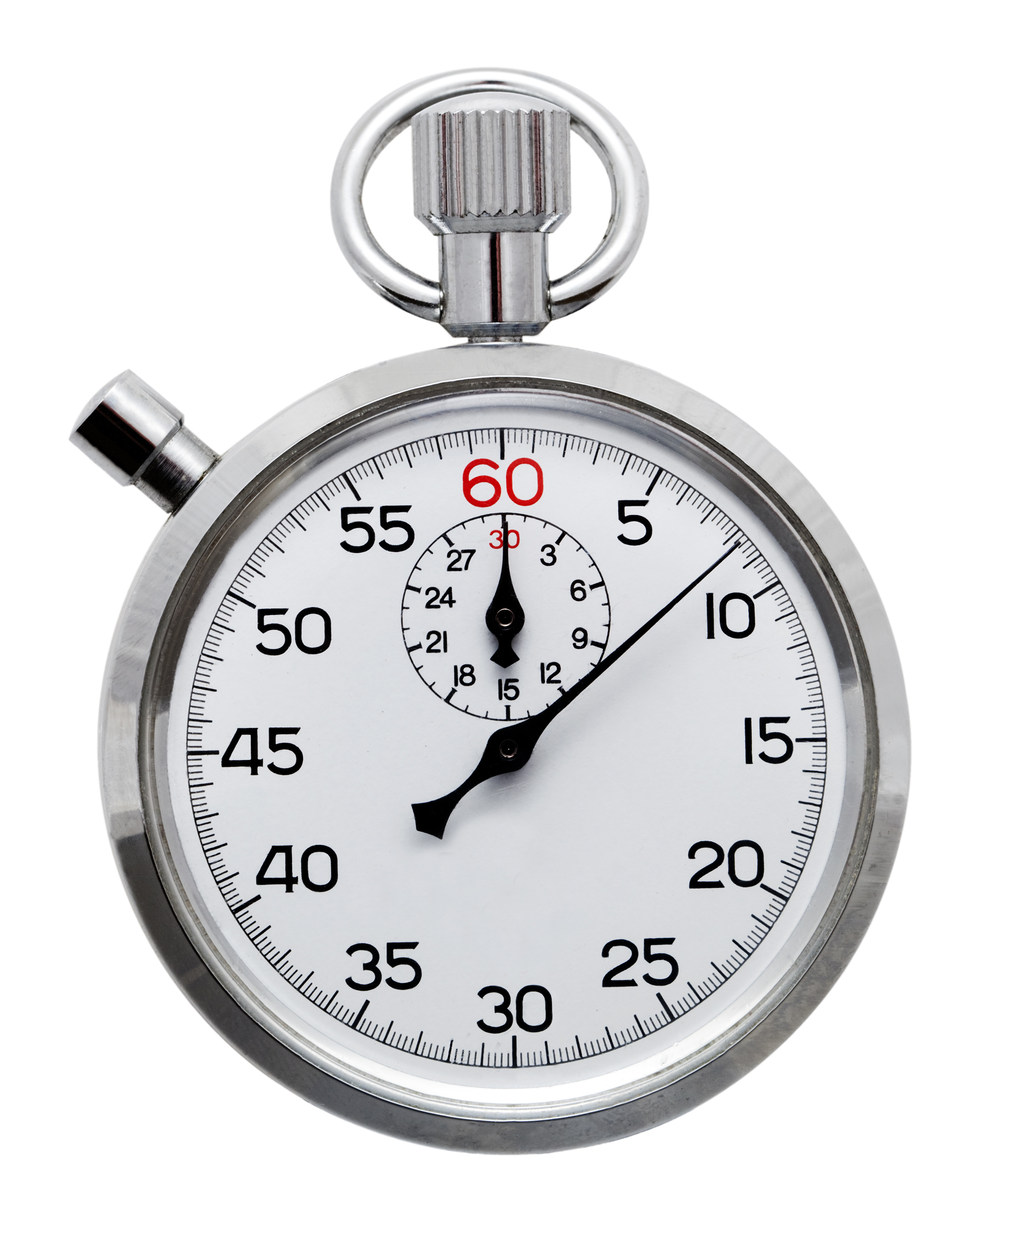
Task Initiation Strategies
-Set a timer for 10 minutes and start working for ten minutes. Use your adrenaline to see how much you can get done in 10 minutes. How did that feel? Could you do 15 minutes more? If so, that's 1 pomodoro! A timer can sometimes bust through your apprehension to start and harness some adrenaline.
-Talk yourself through the steps of a project. Make a chart or an outline to start. Chunk the work into pieces.
-Exercise before sitting down to work.
-Start with a category if that feels more manageable. Ie if you need to clean your office, start with cleaning just surfaces. Then just floor. Then dishes. Then folders. Then just papers etc
-Address your physical comforts. Standing desk? Turn up AC?
-Address emotional barriers to getting started. More on this later.
-Manage distractions and use rewards for completing small chunks of work. (remember to use your distraction log)
Create artificial deadlines for your chunks of work
-”Satificing” (Done is better than perfection. Sacrifice perfection to satisfy the requirement of completion of a task.)

Slide 21
Emotional Barriers to Task Initiation
“Its too hard”; “I want it to be perfect”; “It’s too big”; “I don’t care”; “It will take too long!” ” I don’t know what I’m supposed to do!”
Consider what your emotional barriers may be and how you can provide yourself some help with the barrier. (Fear? Guilt? Dread? ) We can use negative emotions to fuel energy to complete tasks. “I don’t want to feel dread as the deadline looms.”
Address physical barriers to work (comfort-too hot; too cold, too loud, not loud enough etc)
If you have unrealistic expectations of yourself, consider DONE is better than PERFECT so let go of perfection. Make the task clearer by dividing it into smaller sections. Address why you don’t care and find a reason to care ie ”(___will be proud of me).” Try to tell a story about someone who successfully tackled the project. Apply those steps to yourself.
Stop using inflexible language (“I have to do this”) and use self-responsible language (“I choose to do this”). You have agency! Use that narrative instead!

Slide 22
Instant Gratification Vs Do What Makes Sense (Fun and Easy) (Rational Decision Making)
Don’t let the “Instant Gratification Monkey” rule (Tim Urban TED Talk)
Must rely on Deadlines if the Monkey is in charge (Deadline=Panic+Adrenaline)
The “Instant Gratification Monkey’s Dark Playground” is full of guilt, dread, and sense of doom.
Do what makes sense by making it as fun and easy as possible
Create artificial deadlines where there are none
Develop momentum with timers, breaks, project planning, strategy

Slide 23
Use the ADHD Flow… sidestep the rules and go for it…but allow for back-tracking.
Sometimes it’s difficult to get started with a task because there are too many and it becomes overwhelming. ADHD Flow (This is a Rebecca term) is letting your ADHD run wild for a little while. When you are doing a task and get distracted by another task, and then another task, let these natural transitions direct your efforts. After a period of time, perhaps an hour, be sure to reserve time to back track through all of the projects you began, and try to either tidy up or finish each one.
Example: You start to vacuum the living room. You put away the Winter Boots by the door. When you go to the closet with the boots, You notice the plants need watering. As you are watering plants, you see dishes in the sink that need to go in the dishwasher, and as you load the dishwasher you notice the the kitchen floor is dirty. As you mop the floor, you see the dog’s water bowl needs filling. After you fill the water bowl, start back tracking and finishing small details of each task that you may have missed. Did you close the closet? Did all the plants get watered? Did you start the dishwasher? Did you put away the mop? Finish each task! (be sure to set aside time to back track. Otherwise ADHD flow drives the people you live with a little nuts.)

Slide 24
Week 5 Emotion Regulation Strategies

Slide 25
Emotional Regulation
Get to know your emotions. Become comfortable identifying different feeling states.
-Identify which emotions are toughest for you. Some examples: Rage, Fear, Shame, Embarrassment, Confusion can often be challenging for many people. What are the times you tend to get wrapped up in emotion?
-Everyone has an Emotional Mind and Logical Mind. Try to think about having both minds active in a difficult situation. When they are combined, (when you use feelings and logic together) they are called “Wise Mind.” (DBT concept)
-Using reflective practices (yoga, guided meditation etc) which may help you improve your emotional baseline and ability to calm and present
-Tell yourself you can tolerate criticism, challenges, and negative feedback. Learn to hear feedback. --Learn to take 3 deep breaths before responding if feeling triggered.
-Sometimes we spend more energy avoiding an emotion than figuring out how to handle an emotion. Journaling can help you understand your feelings more and then help you strategize ways to cope with the feelings.
-Under anger is often fear or sadness. Can you connect to those feelings instead?

Slide 26
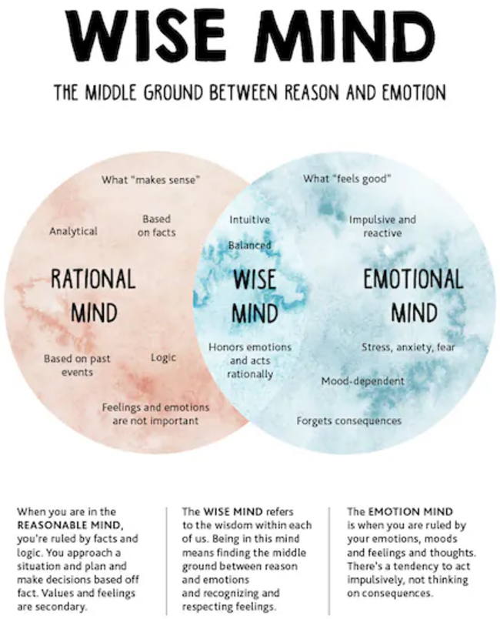
Notes:
Dialectical Behavioral Therapy Concept

Slide 27
Remember TIPP When Distressed
T Temperature
I Intense Exercise
P Paced Breathing/ ie Box breathing
P Progressive Muscle Relaxation
Reduce Intense Emotions Quickly so that you can proceed effectively.
Cold Water will activate parasympathetic nervous system, slows heart rate. Dip face into bowl of ice water. Intense exercise is a release for extra energy that can come with feeling upset. After you stop the heart rate goes down. Paced Breathing moves our breath deeply into our lungs. Slowing breath will slow your heart rate and emotion intensity. Progressive Muscle Relaxation can deeply relax the mind and body by tensing and relaxing muscle groups. When finished with any of these you will feel more relaxed and more able to be effective in a difficult times.
Notes:
DBT Concept

Slide 28
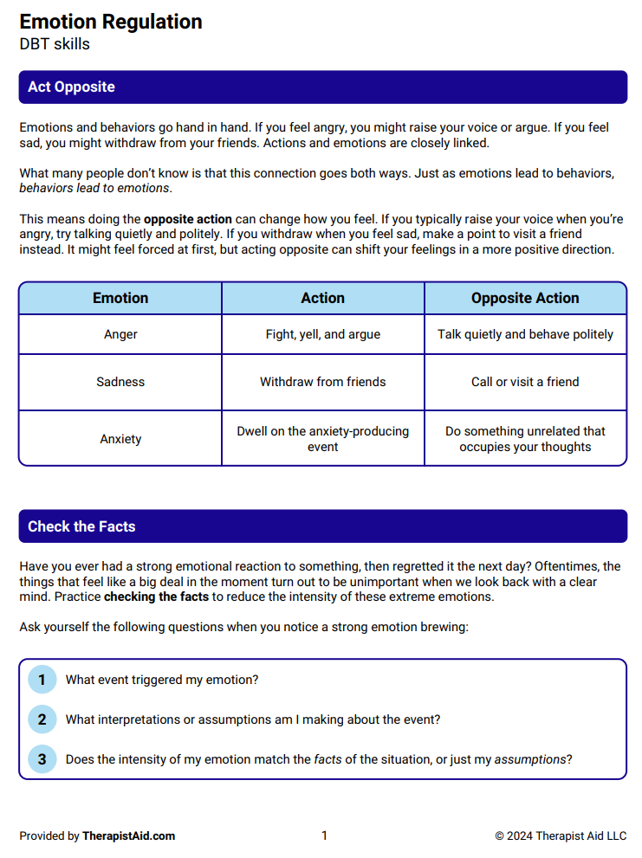
Notes:
DBT Concept

Slide 29
Notes:
Cognitive Behavioral Therapy Concepts. Learn to change distorted thoughts into ways you would speak to a best friend or small child.

Slide 30
Practice Radical Acceptance
This is the concept that when bad things happen to us we can choose to accept reality because in doing so we can inoculate ourselves to suffering. We accept actively with radical acceptance. It doesn’t mean giving up or resignation. Radical acceptance means recognizing that we have the feelings we have, and we must also face and deal with the cards we were dealt. When we don’t run away from reality we can be more effective and more able to manage stressors well. A benefit of radical acceptance is that within accepting what is, we can look for the things we can do, and let go of that which we cannot control. Notice, Allow in, and let be.
By shutting out reality and fighting it, we suffer. Accepting brings peace.

Slide 31
Week 6 Mental Flexibility Strategies
State the color of each word below.
Blue, Red, Yellow, Green, Purple, Orange
Light Green, Magenta, Violet, Turquoise

Slide 32
Mental Flexibility Strategies
People who are emotionally flexible are better romantic partners and better equipped for family life and work success. Learning to be collaborative and allowing for other ideas or options can feel like a relief for some. It means asking for help or asking for ideas as well as learning to un-attach from your own views sometimes.
Learn to say "I never thought of it that way!" Or "I'll have to think about that point of view!/that idea!" Or Consider that your assumptions may be untrue. Question your own assumptions!
Use Brainstorming to solve problems. This can unlock other options that your brain wasn't considering. List ideas without judgement.
People with ADHD tend to be enthusiastic and creative. Use that enthusiasm and creativity to generate new ways to see a situation or a circumstance.
Nothing is a "catastrophe" so learn to think about problems as opportunities to use your flexible thinking. Avoid black and white thinking! Look for the grey!

Slide 33
Name 3 Things You Can Do About It…
1) You are at the park and someone gets hurt and is bleeding.
2) You arrive at the airport and you have missed your flight.
3) Your friend is making your favorite dish but is missing a key ingredient.
4) Mid-day you notice your shoes feel painful and tight on your feet.
5) There’s a storm and the power goes out
6)You and a friend have tix to the theatre. Your friend gets sick and can’t go.
7)You stepped in gum.
8)You are taking a class and you don’t know anyone.
9) Your neighbor has extra mulch and says come get it before the rain comes. You are busy all day...
10) You arrive at a restaurant to meet friends and it’s too loud for you. You can’t hear anyone.
Notes:
Ask what assumptions you are answering with? What if those assumptions are different?

Slide 34
Week 7 Impulse Control Strategies
Conversation is not a race
Sending off impulsive emails can often lead to problems at work
With each potential outcome consider consequences that may arise -“Play The Tape Forward” is another way to remind yourself to link behavior choices to outcomes
*Play the tape forward example: If you want to and have the impulse to eat more sweets after dinner, think about stepping on the scale the next morning.
Choose good fidget toys (non primary focus)

Slide 35
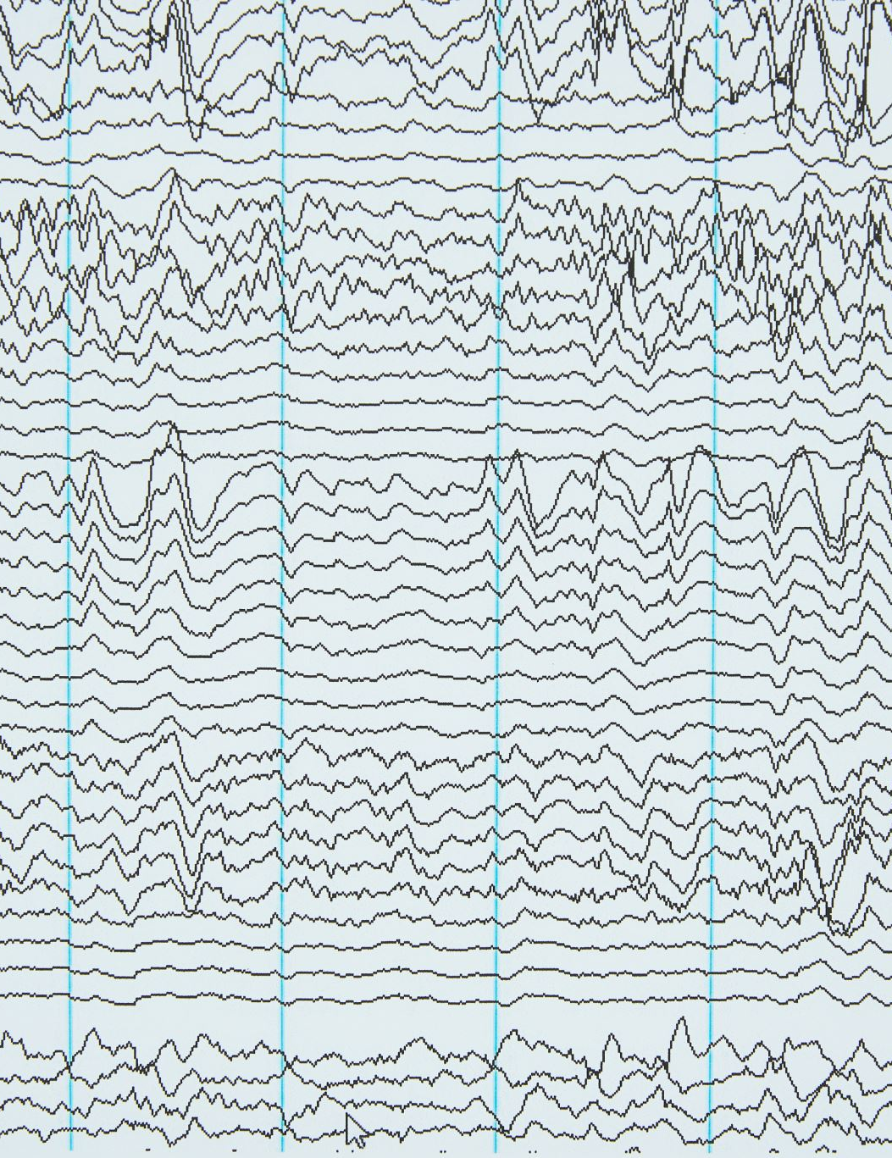
Impulse Control Strategies
-Delay Gratification. Each time you delay gratification you are building up a muscle. This muscle allows you to build your confidence in your ability to make good choices.
-Rather than blurting things out during conversation you can always send a thoughtful email after the fact.
-When tempted to be impulsive with behavior that can lead to trouble, picture some potential consequences.
Consider the consequences of gambling, drinking, using drugs, spending money, or making a joke at someone else's expense.
-If you find yourself interrupting someone when they are speaking, apologize and ask them to finish their thought. (Many people with ADHD have developed the habit of interrupting others when they are speaking or busy.) Grow this awareness so you can be a better conversationalist and people will be less frustrated with you.
-When unsure of an appropriate response to an opportunity to be impulsive, consider what someone you admire would do in your exact situation.
“If I prioritize the future over right now, does this change my behavior choice?”

Slide 36
Map Out Where To Intervene

Slide 37
Impulse Control Opportunities! What do you do when...
There's a giant bowl of M&M's on the table at a friend's house. You love M&M's.
There's a box of puppies outside the grocery store with a homeless person. There's a sign that says "free puppies." You love puppies.
There's a button on the wall that says "this button will activate emergency personnel." You feel like pressing it.
You are at a work party with colleagues. Someone dares you to dance on a table. You love to dance.
Your ex (who you never fully got over) calls and asks you to come over and it's late.
(How will you answer these if you prioritize your future?)

Slide 38
We Made it to Week 8! WRAP UP!
What strategies are working for you?
What are you still struggling with?
What additional questions do you have about ADHD?

Slide 39
The Positives of the ADHD Brain
Enthusiasm
Creativity
Energy
Hyper-focus
Spontaneity
Resilience
Can embrace chaos and create order
Can thrive with an imminent deadline

Slide 40
Removing Barriers to Success
ADHD affects these areas of executive functioning: attention and concentration, organization and planning, working memory, task initiation, emotional control, mental flexibility, and impulse control. If weaknesses in these areas are hurting your ability to function well at school or in your employment, you can request Accommodations from your Human Resources Dept, as long as you are willing to disclose to HR that you have a condition protected by the ADA (Americans with Disabilities Act) or ADHD. Employers are required to keep their employees’ health information confidential. That means others on the team will not necessarily know the details behind an accommodation unless you inform your colleagues. An accommodation is a change that removes a barrier to learning or getting work done. First identify the barrier. Is it a loud room, written text, lack of structure, needing to stay seated, or something else?
You will need a letter from your doctor or BH Provider to confirm your condition.
Some accommodations that can be requested: (front row seating; first choice of classes during registration so the time of class works for you; headphones when needing to focus quietly (music with no words); Breaks to move around; ability to stand during work hours if sitting is difficult; Schedule changes that work best for you (early morning meetings could be scheduled in the afternoon instead?); fidget toys available at your work station; post it notes with your to-do list for the day within your work station; “walking meetings,” flexible lighting options, flexible breaks, written agendas provided before meetings, recap emails after meetings, pictures or videos showing how to complete tasks, checklists and progress bars at your work station, written instructions with clear steps and expectations.

Slide 41
Resources for help with Accommodations
https://www.understood.org/en/articles/faq-ada-at-work
https://www.understood.org/en/articles/faq-ada-at-work
https://www.understood.org/en/articles/reasonable-workplace-accommodation-examples
Have questions about accommodations? Visit ADA.gov, or call the ADA information line at 1-800-514-0301 (voice) or 1-833-610-1264 (TTY).

Slide 42
Podcasts:
Dr Nowell “Overview of ADHD”.
Dr. Hallowell “The Bright Side of ADHD” and “Ned Hallowell’s Step-by-Step Guide to Adult ADHD” and “ADHD Life Coaching with Dr. Ned Hallowell.” Also “Dr. Ned Hallowell’s Wonderful World of Different”
Tracy Otsuka “ADHD for Smart Ass Women”
Katy Webber “Women and ADHD”
CHADD “All Things ADHD”
The Kaleidoscope Society “ADHD Decoded”
David A Green “Overcoming Distractions”
Kate Moryoussef “The ADHD Women’s Wellbeing Podcast”
Skye Rapson “The ADHD Skills Lab”
ADDitude “Strategies and Support for ADHD and LD”
Eric Tivers “ADHD Rewired”
Sara Snyder “Adulting with ADHD”
William Curb “Hacking Your ADHD”
Nikki Kinzer & Peter Wright “Taking Control; The ADHD Podcast”
Understood Podcast Network “ADHD Aha!”

Slide 43
Playlists:
This is a Spotify playlist that originates from video games and kids tend to like for Focus/Thinking
https://open.spotify.com/playlist/3tOCS8stne2kjTFOpbiJ5p?si=5idAPsb0RcGfAdAOzfrRUg&utm_source=copy-link
ADHD Hyperfixation Playlist
This is a massive list of music on Youtube for Hyperfixation created by a Spotify user with ADHD
(Spotify has many Playlists):
ADHD Focus Music 2024; ADHD Work Mode; ADHD Hyperfocus Stimulance; ADHD DEEP FOCUS; ADHD Background Music; Energizing Focus Mix; Work Flow; Brown Noise for Studying, Bilateral Stimulation Music; ADHD Sensory Calming
(You Tube Music has many ADHD Play lists): Use any ADHD search term above

Slide 44
APPS
WAKE UP
Wake N Shake (iOS, $0.99) You have to vigorously shake your iPhone to shut off the alarm.
I Can’t Wake Up! (Android, free) You have to do eight wake-up tasks before the alarm is silenced.
Clocky and Tocky ($39.99, $49.99) These alarm clocks jump off your nightstand and roll around the room while playing your favorite MP3s.
CALM DOWN, FALL ASLEEP, OR PAY ATTENTION
Relax Melodies (iOS and Android) Creates a white noise ambience for falling asleep or meditation.
Sleep Deeply (iOS and Android, $6.99) A hypnotherapist puts you in a relaxed state.
White Noise (iOS and Android, free lite version and $1.99 full version) Features natural and man-made sounds.
Calm app
KEEP TRACK OF TIME
Watchminder (iOS, $1.99) Set alarms and get reminders to help you focus.
TimeTimer (iOS, $2.99 and Android, $0.99) Displays the passage of time visually.
Pomodoro Timer Lite (Android, free) Focus for 25 minutes, and the timer signals it’s time for a break.
FocusTime (iOS, $.4.99) Set work and break intervals.
Apple Watch with Calendar Reminders highly recommended for wearable reminders
FIND LOST ITEMS
Find My iPhone (iOS, free)
Find My Phone (Android, free)
Find One Find All Attach a sensor to your keys or other items. Press a button and the item beeps.
Tile.com Tile also uses Bluetooth and an App called Tiles. The tile can help you locate anything you attach a tile tracker to. (recommended for wallet, keys).

Slide 45
SET REMINDERS
iCalendar (iOS, free) and Google Calendar (Android, free) Both sync with cell phones, allowing you to schedule online, and to send reminders by e-mail or text.
Watchminder (iOS, $1.99) Organize schedules and manage time.
Echo Dot; Alexa, “Hey Siri” …wake me up tomorrow at 7:00am
… Set Timer for 1 hour
….Set Timer for 10 minutes
…Add milk to my grocery list

Slide 46
BLOCK THE INTERNET (to eliminate distraction when reading/studying)
Keep Focus (Android, free)
Freedom (iOS and PC, free trial then $2.42/month)
SelfControl (Mac)
Forest The "forest" Avoid getting distracted by phone/social media when I have work to get done. User sets a timer and plants a cute tree, during that time the apps on your phone are (sort of) blocked (you can add exclusions like Spotify for music). If you try to open social media for example it will ask you if you really want to and if you say yes the tree will die but if you manage to not use other apps the tree will grow and be added to your garden. You then earn coins to buy more kinds of tree/flowers which keeps it from getting too boring and gives something to work towards.
LISTEN TO PRINTED DOCUMENTS
Voice Dream (iOS, $19.99) Listen to PDF and Word documents, e-books, articles, and Web pages anywhere with this text-to-speech app.
Read&Write (iOS, Android, free) Text-to-speech software similar to Voice Dream.

Slide 47
Ongoing Support through Reliant Medical Group
Monthly ADHD Support (“Alumni Group”) is available to those Group 7 Participants who want to continue to maintain some peer support for living with ADHD. This is a peer support group and intended to provide both support and positive conversation geared toward helping each group member to apply strategies they learned to their every day challenges.
Please speak with Rebecca or send a mychart message to Rebecca (Steil-Lambert) if you would like to be included in the monthly Support Group. If you have 3 no-shows you will be removed from the invite list.

Slide 48
Recommended Content by Group Members
Shorts on YouTube regarding ADHD (time blindness etc)
Binaural Beats “MindMend”
Coldturkey (blocker app)
Reclaim AI calendar app
Rescue Time (how much time I spend on…FB etc)
“How To ADHD” on You Tube
The Anti-Planner (Lots of positive feedback on this!)

