Slide 1
My Life, My Recovery
The Benefits of Self Care in Recovery
Melanie Savoy, LDAC

Slide 2
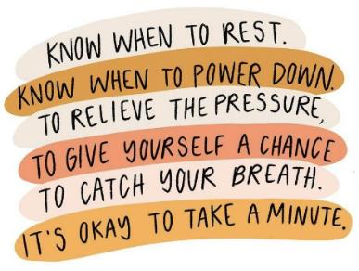
Self Care Aids in Recovery

Slide 3
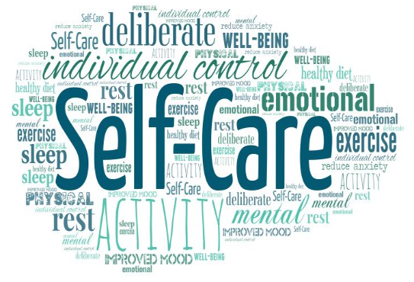
What is “Self Care”?
Self-care is the conscious act of taking responsibility for oneself through behaviors that encourage overall healthy well-being.
Self-care can manifest, whether spiritually, mentally, physically, or emotionally.
It can look like creating daily routines and incorporating habits such as exercise or journaling that help keep you grounded.

Slide 4
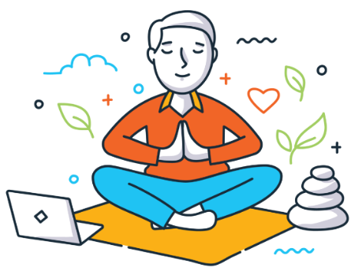
Why is Self Care Important to the Recovery Process?
Substance misuse dramatically affects a person by negatively impacting different areas of life.
Addiction affects your mood, appetite, physical and emotional well-being, personal relationships, finances, and many other areas of life.
Maintaining long-term sobriety will require various lifestyle changes.
The decision to actively commit to the choices that help take care of your mental, physical and emotional health is essential to succeed.
Notes:
Picture: https://www.google.com/url?sa=i&url=https%3A%2F%2Fhealthysd.gov%2Fself-care-at-work%2F&psig=AOvVaw0YcmBxcF_FR2MPlzzWY6Nm&ust=1717147450956000&source=images&cd=vfe&opi=89978449&ved=0CBIQjhxqFwoTCMCr9_aGtYYDFQAAAAAdAAAAABAE

Slide 5
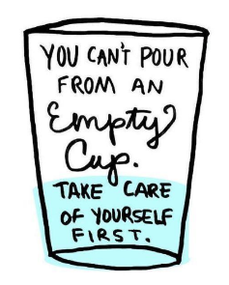
Benefits of Self Care
Fosters Physical Wellbeing
Enhances Mental and Emotional Health
Rebuilds Connections in the Community
Creates Structure and Routine
Builds Self-Discovery and Personal Growth
Notes:
Picture: https://www.google.com/url?sa=i&url=https%3A%2F%2Fwww.nccjtriad.org%2F2019%2F11%2F21%2F5-tips-for-self-care%2F&psig=AOvVaw0YcmBxcF_FR2MPlzzWY6Nm&ust=1717147450956000&source=images&cd=vfe&opi=89978449&ved=0CBIQjhxqFwoTCMCr9_aGtYYDFQAAAAAdAAAAABAK
Article Source: https://selfhelp.education/physical-self-care/addiction/the-importance-of-self-care-in-addiction-recovery/
Fostering physical well-being
Nutrition: Eating a balanced diet with all the necessary vitamins and minerals helps repair the body and provides the energy needed to engage in recovery.
Exercise: Regular physical activity releases endorphins, which act as natural mood boosters. Exercise also helps rebuild physical strength and reduces stress, both of which are essential in recovery.
Sleep: Restorative sleep is paramount to healing.
Enhancing mental and emotional health
Stress Management: Learning and practicing stress management techniques, such as meditation or yoga, can significantly improve the ability to cope with cravings and triggers.
Emotional Expression: Finding healthy outlets for emotions, like therapy or journaling, is essential to the recovery process.
Recreation: Engaging in hobbies and activities that bring joy can provide positive distractions and help rebuild a sense of identity beyond addiction.
Rebuilding Connections and Community
Support Networks: Reconnecting with friends, family, and support groups can provide much-needed emotional support.
Creating Structure and Routine
A structured routine provides focus on the present moment and a commitment to one’s well-being.
Building Self-Discovery and Personal Growth
Self-care is also a journey of self-discovery, unveiling interests, values, and strengths that may have been overshadowed by addiction.
It paves the way for personal growth and the development of new coping strategies for life’s challenges.

Slide 6
How to Implement Self Care
Assess
Identify your self care needs
Remove any barriers
Write Down practices that support your needs
Fit them into your schedule
Notes:
Assess
Take a look at your current habits.
Observe where you are now.
Identify your self-care needs
Think about what you value most in your day-to-day life.
Write down practices that support your needs
What activities bring me joy?
What helps me feel energized?
When do I feel at peace?
What makes me feel fulfilled?
What’s helped me cope with difficult moments in my life?
Fit them into your schedule
Find pockets of time throughout your busy day to do these practices.
Remember, self-care isn’t selfish. It’s an act of kindness to yourself.
Evaluate how these self-care practices are helping you improve yourself and add more to your plan as you go along.
Remove any barriers
Begin by reducing and then removing harmful coping habits.
Pick the most detrimental one and replace it with a self-care practice instead.

Slide 7
Group Discussion
Group Discussion
Notes:
Do you engaged in any type of self care?
Why or why not?
What are your self care goals?
What are you currently doing to achieve these goals?

